Slide 1

Capstone Project NBA DATA ANALYSIS
By – RAJAT PARMAR

Slide 2
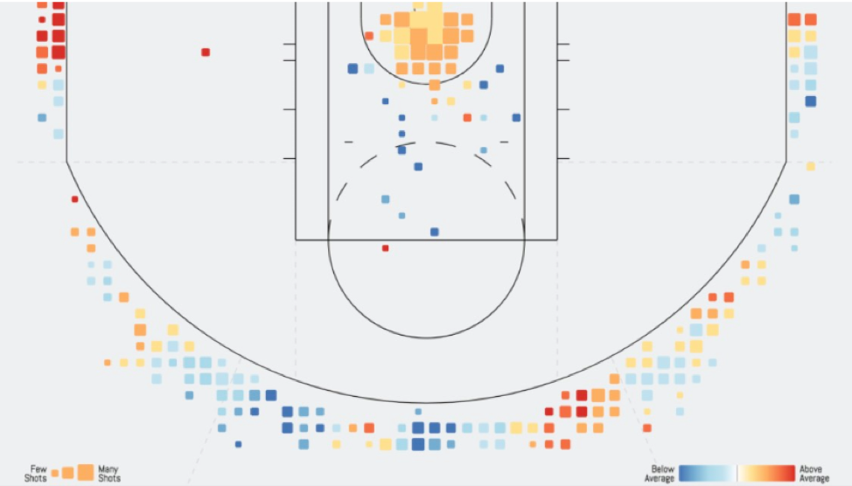
AGENDA
PROJECT GOALS
PROJECT IMPORTANCE
PROCESS
RESULTS
CHALLENGES
FUTURE GOALS

Slide 3

PROJECT GOALS
This project involves the analysis and visualization of NBA data with a particular focus on win predictability and team improvement.
In this project we have used latest datasets from basketballrefernce.com and nba.com to analyze all the teams and their chances to win a championship and we have also focused on what parameters the league actually focuses more on which would eventually help a team improve more.

Slide 4
PROJECT IMPORTANCE
This project on basketball game statistics is important for various reasons:
Performance Analysis: Assess player and team performance for improvement.
Player Development: Tailor training programs to individual player needs.
Team Management: Make informed decisions on player rotations, substitutions, and team composition.
Scouting and Recruitment: Evaluate opponents and identify potential recruits.
Injury Prevention: Monitor player workload for effective injury prevention.
Sponsorship and Marketing: Identify high-performing teams and players for sponsorships and partnerships.

Slide 5

PROCESS
In the process of extracting data from sites we have to make sure that we use the data including the latest season.
Reading the datasets (csv files and excel files) to get relevant data to perform operations and manipulation to achieve required results.
Generate several statistics, to include, wins, points, assists, rebounds, home and away games.
Create parameters to check and improve team success.

Slide 6
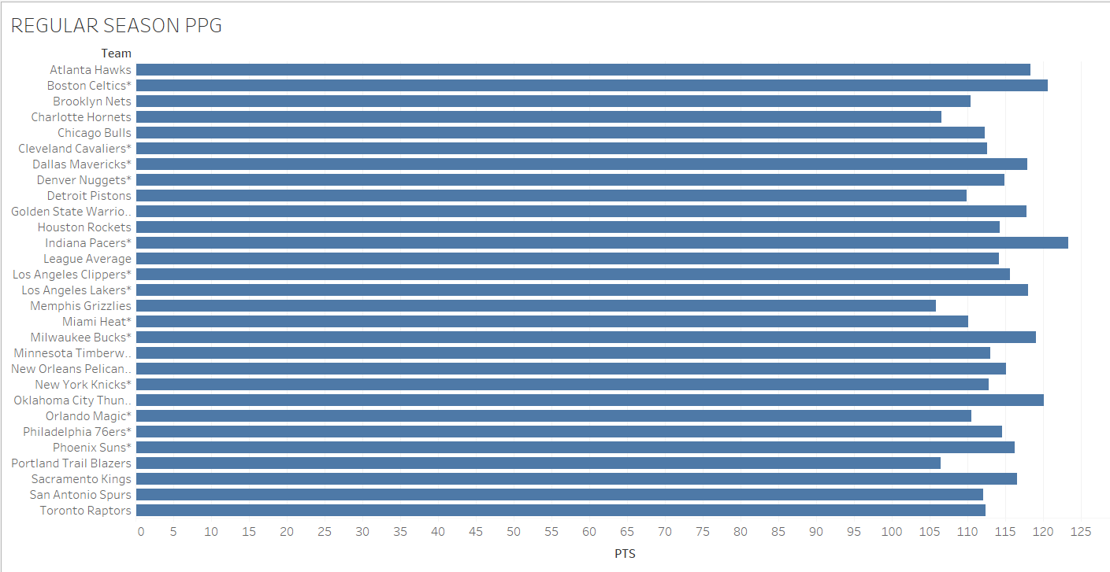
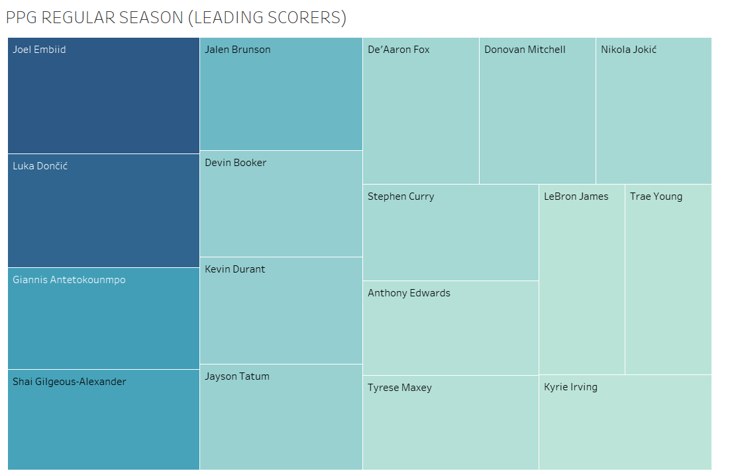
RESULTS
Regular season points per game and regular season leading scorers.

Slide 7
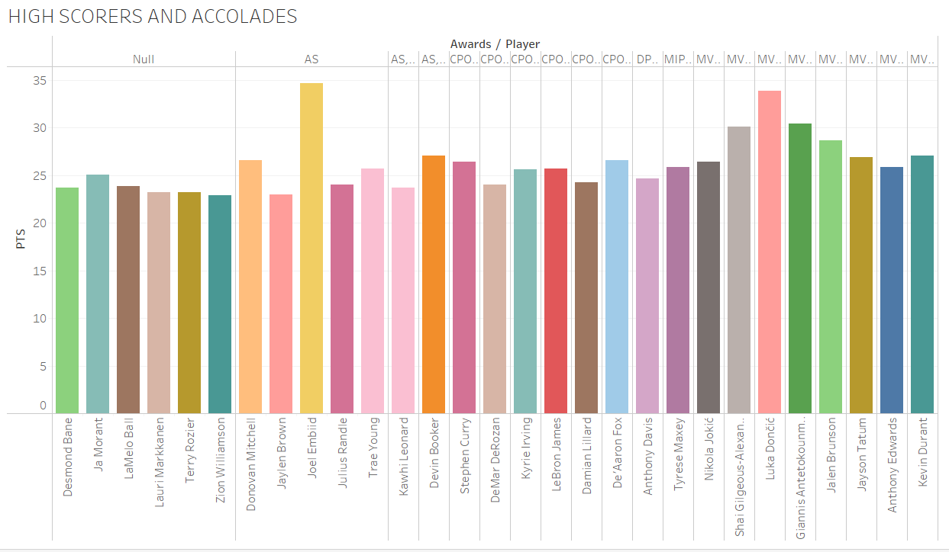
PPG VS AWARDS

Slide 8

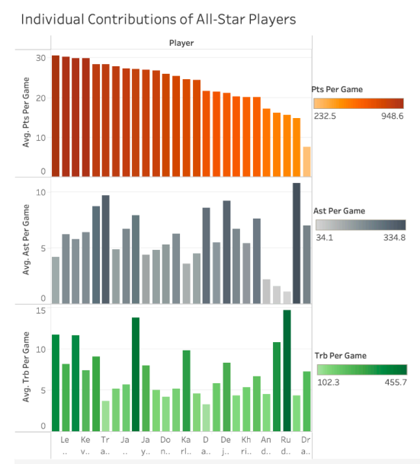
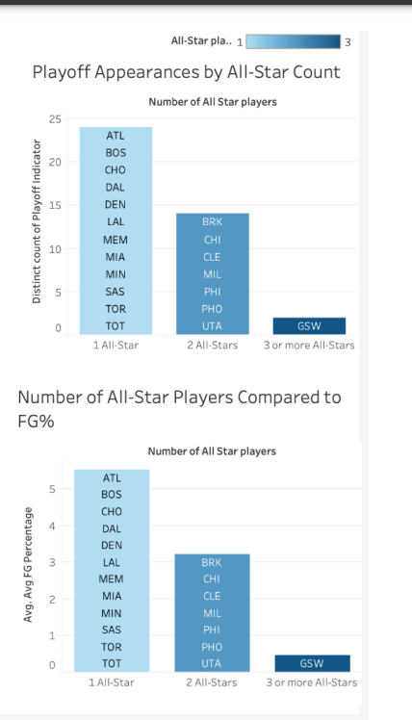

Slide 9
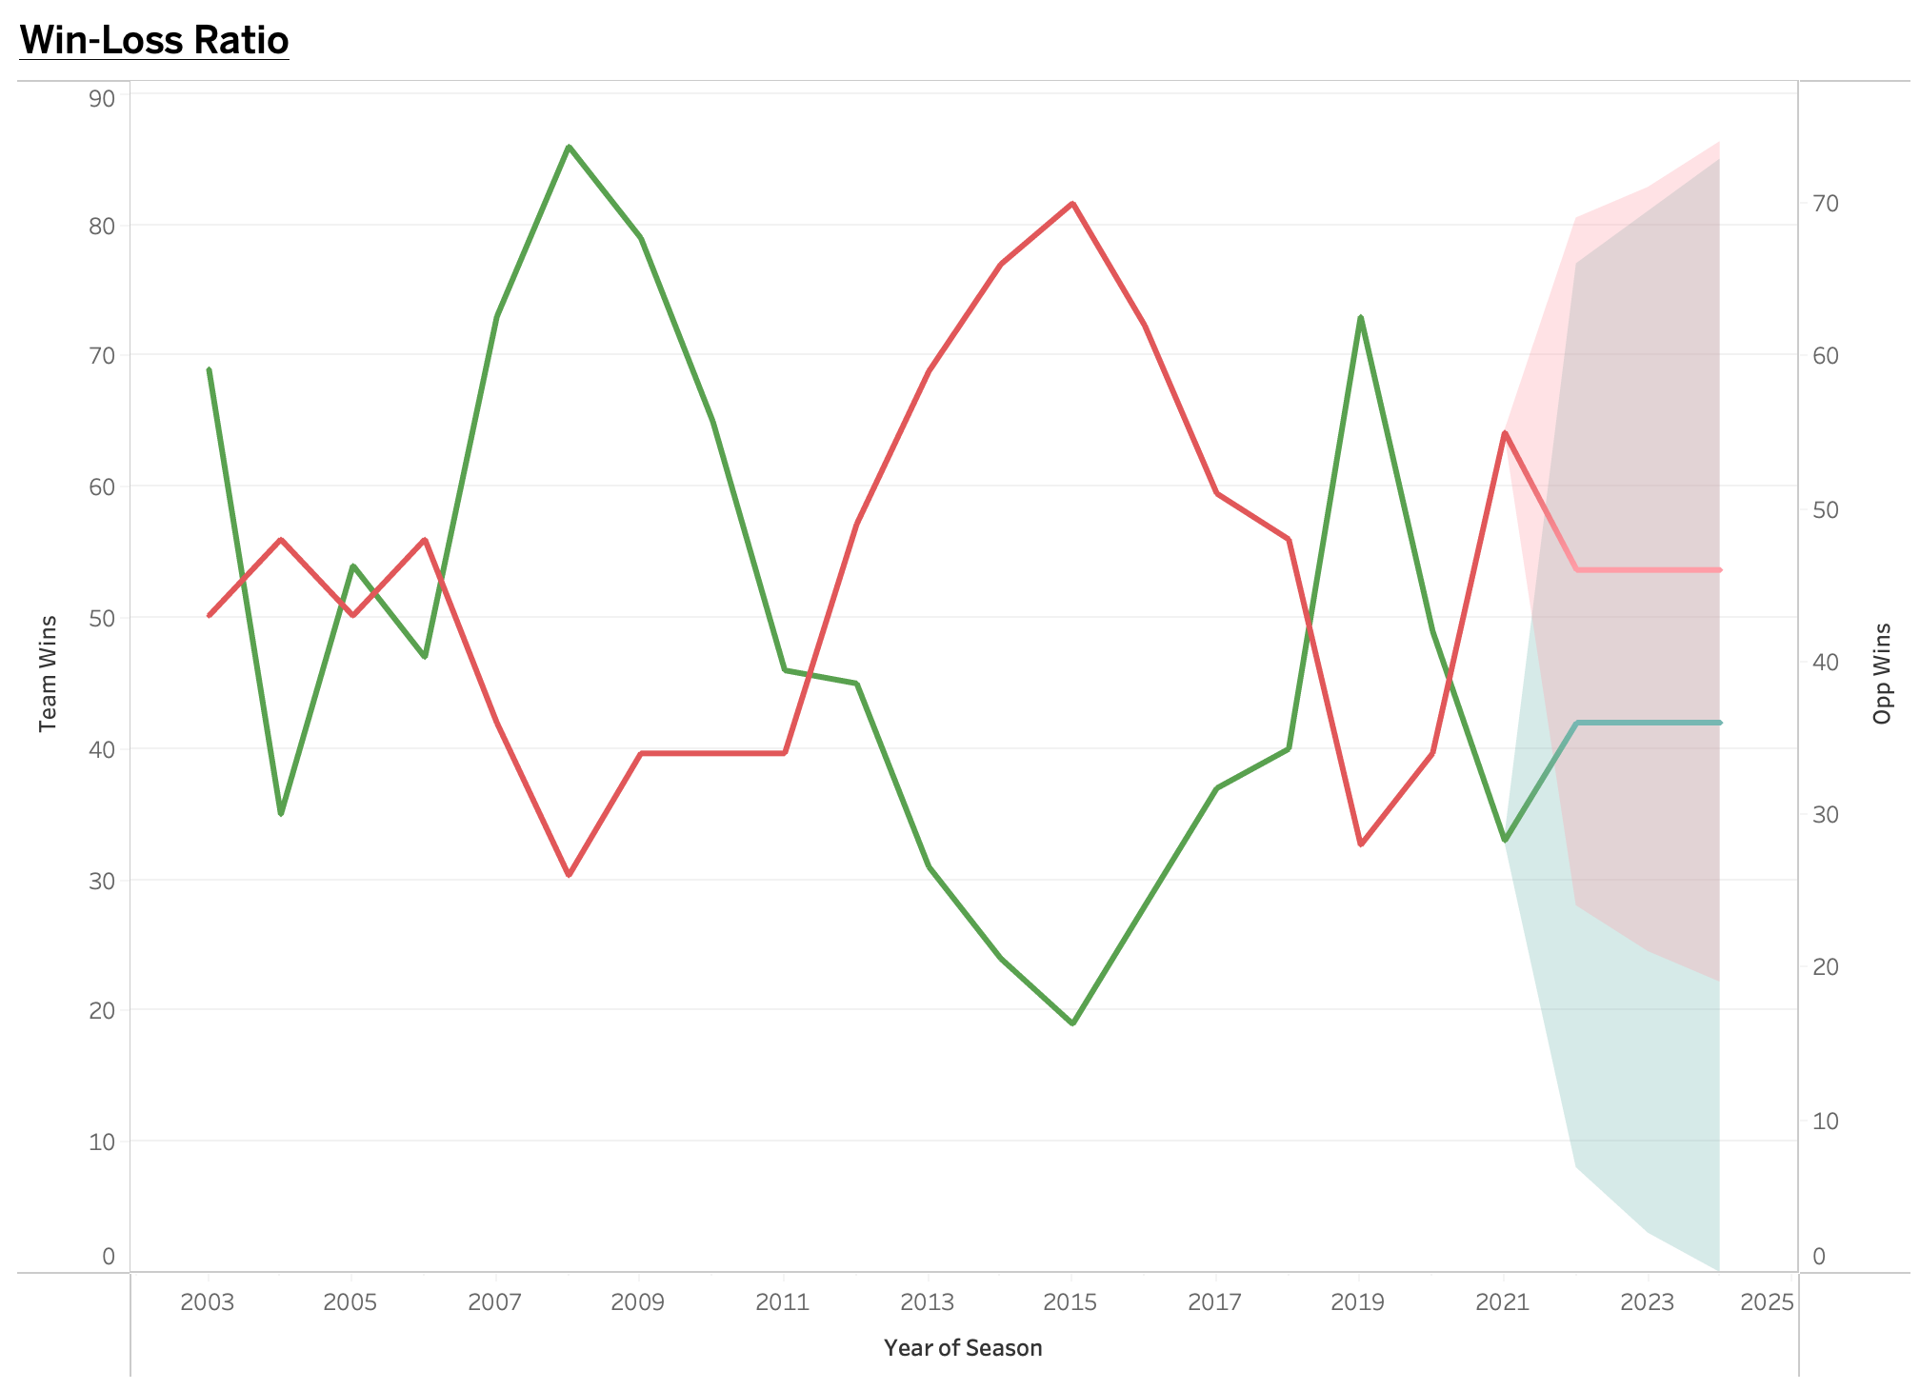
From the dataset, LA Lakers had their most wins (86) in a single NBA season in 2008. Interestingly, even though they won the NBA Western conference, they lost the NBA championship to the Boston Celtics. Conversely, they had their fewest wins (19) in 2015 where they finished bottom of the NBA Western conference

Slide 10
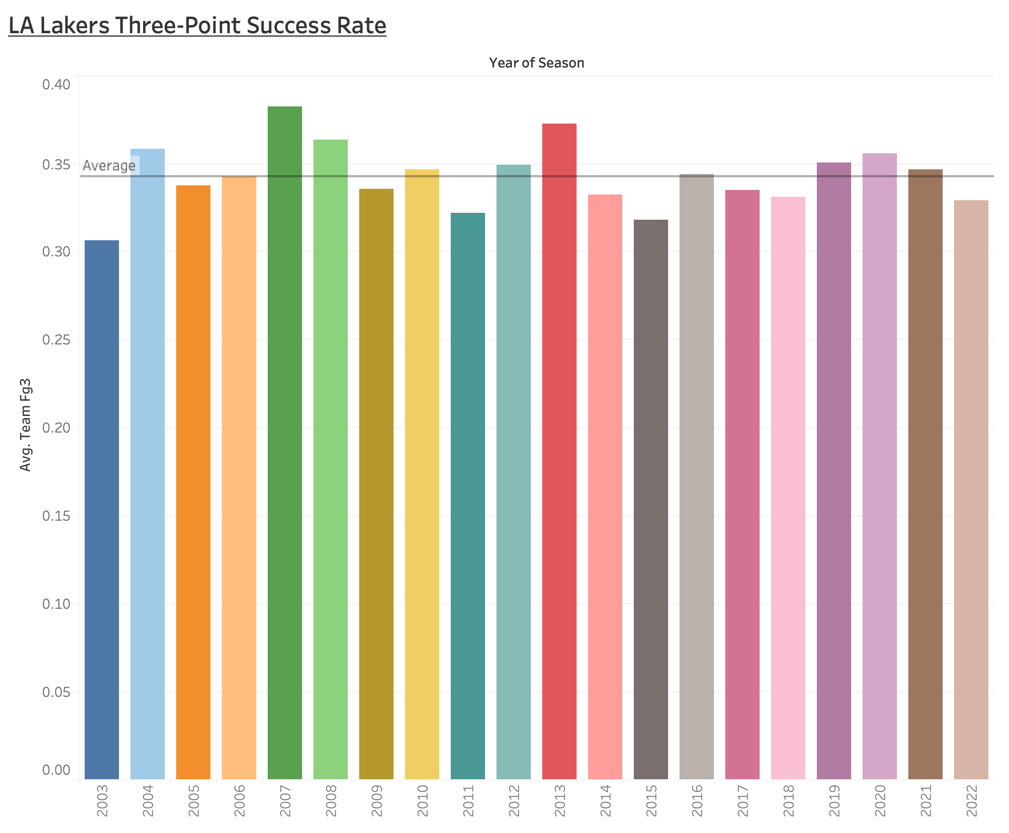
The LA Lakers had their highest 3-point success rate (38.19%) in 2017 and had their lowest 3-point accuracy (30.64%) in 2003. They have an average success rate of 34.28% over the seasons.

Slide 11
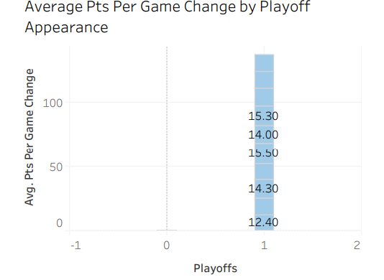
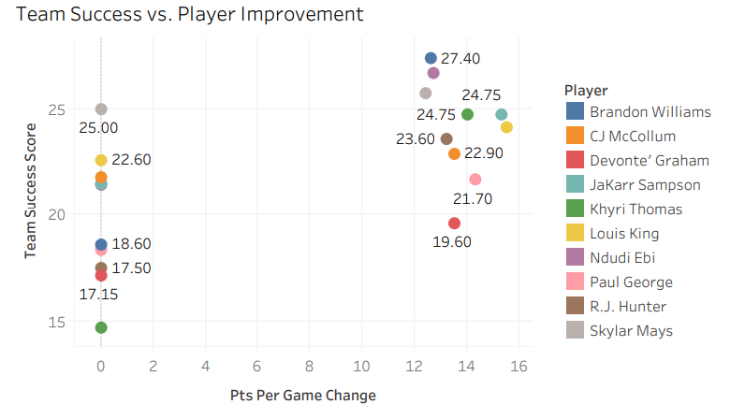
Talent and development vs team performance in the NBA

Slide 12
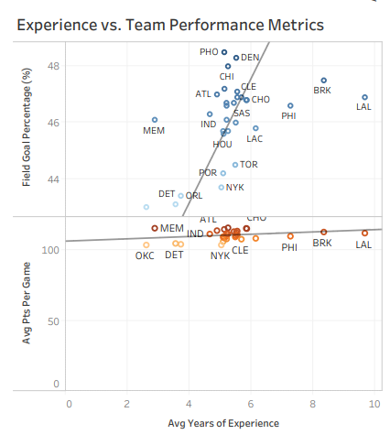
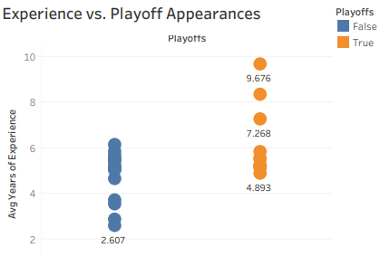
ROSTER COMPOSITION ON NBA TEAM PERFORMANCE

Slide 13

CHALLENGES
Tried to include as many parameters to generate effective results.
Data cleaning and manipulation for players who were traded.
Relationship between certain statistics to illustrate graphs
Designing an effective and user-friendly dashboard to meet diverse stakeholder needs and preferences.

Slide 14
FUTURE GOALS
Explore additional features of the datasets (especially impact of key players performances) for more comprehensive analysis.
Perform more visualizations to better interpret the data and get better deductions.
Refine visualizations and dashboard layout for better user experience

Slide 15

THANK YOU

